Slide 1
[Ruby] TDD & code design best practices
Trainer: Evgenii Danilov

Slide 2
Agenda
Getting known
Goals of this training
Practical examples
QA session

Slide 3
Agenda
Getting known
Goals of this training
Practical examples
QA session

Slide 4
Agenda
Getting known
Goals of this training
Practical examples
QA session

Slide 5
Agenda
Getting known
Goals of this training
Practical examples
QA session

Slide 6
…before we get started
If somebody wants to join the development of the training, feel free to reach me our.

Slide 7
Timing & rules
Two sessions, 1.5 hours for each session
Unmute yourself and ask questions during all the training
Interactive mode with your ideas
Feedback after the training is much appreciated

Slide 8
Timing & rules
Two sessions, 1.5 hours for each session
Unmute yourself and ask questions during all the training
Interactive mode with your ideas
Feedback after the training is much appreciated

Slide 9
Timing & rules
Two sessions, 1.5 hours for each session
Unmute yourself and ask questions during all the training
Interactive mode with your ideas
Feedback after the training is much appreciated

Slide 10
Timing & rules
Two sessions, 1.5 hours for each session
Unmute yourself and ask questions during all the training
Interactive mode with your ideas
Feedback after the training is much appreciated

Slide 11
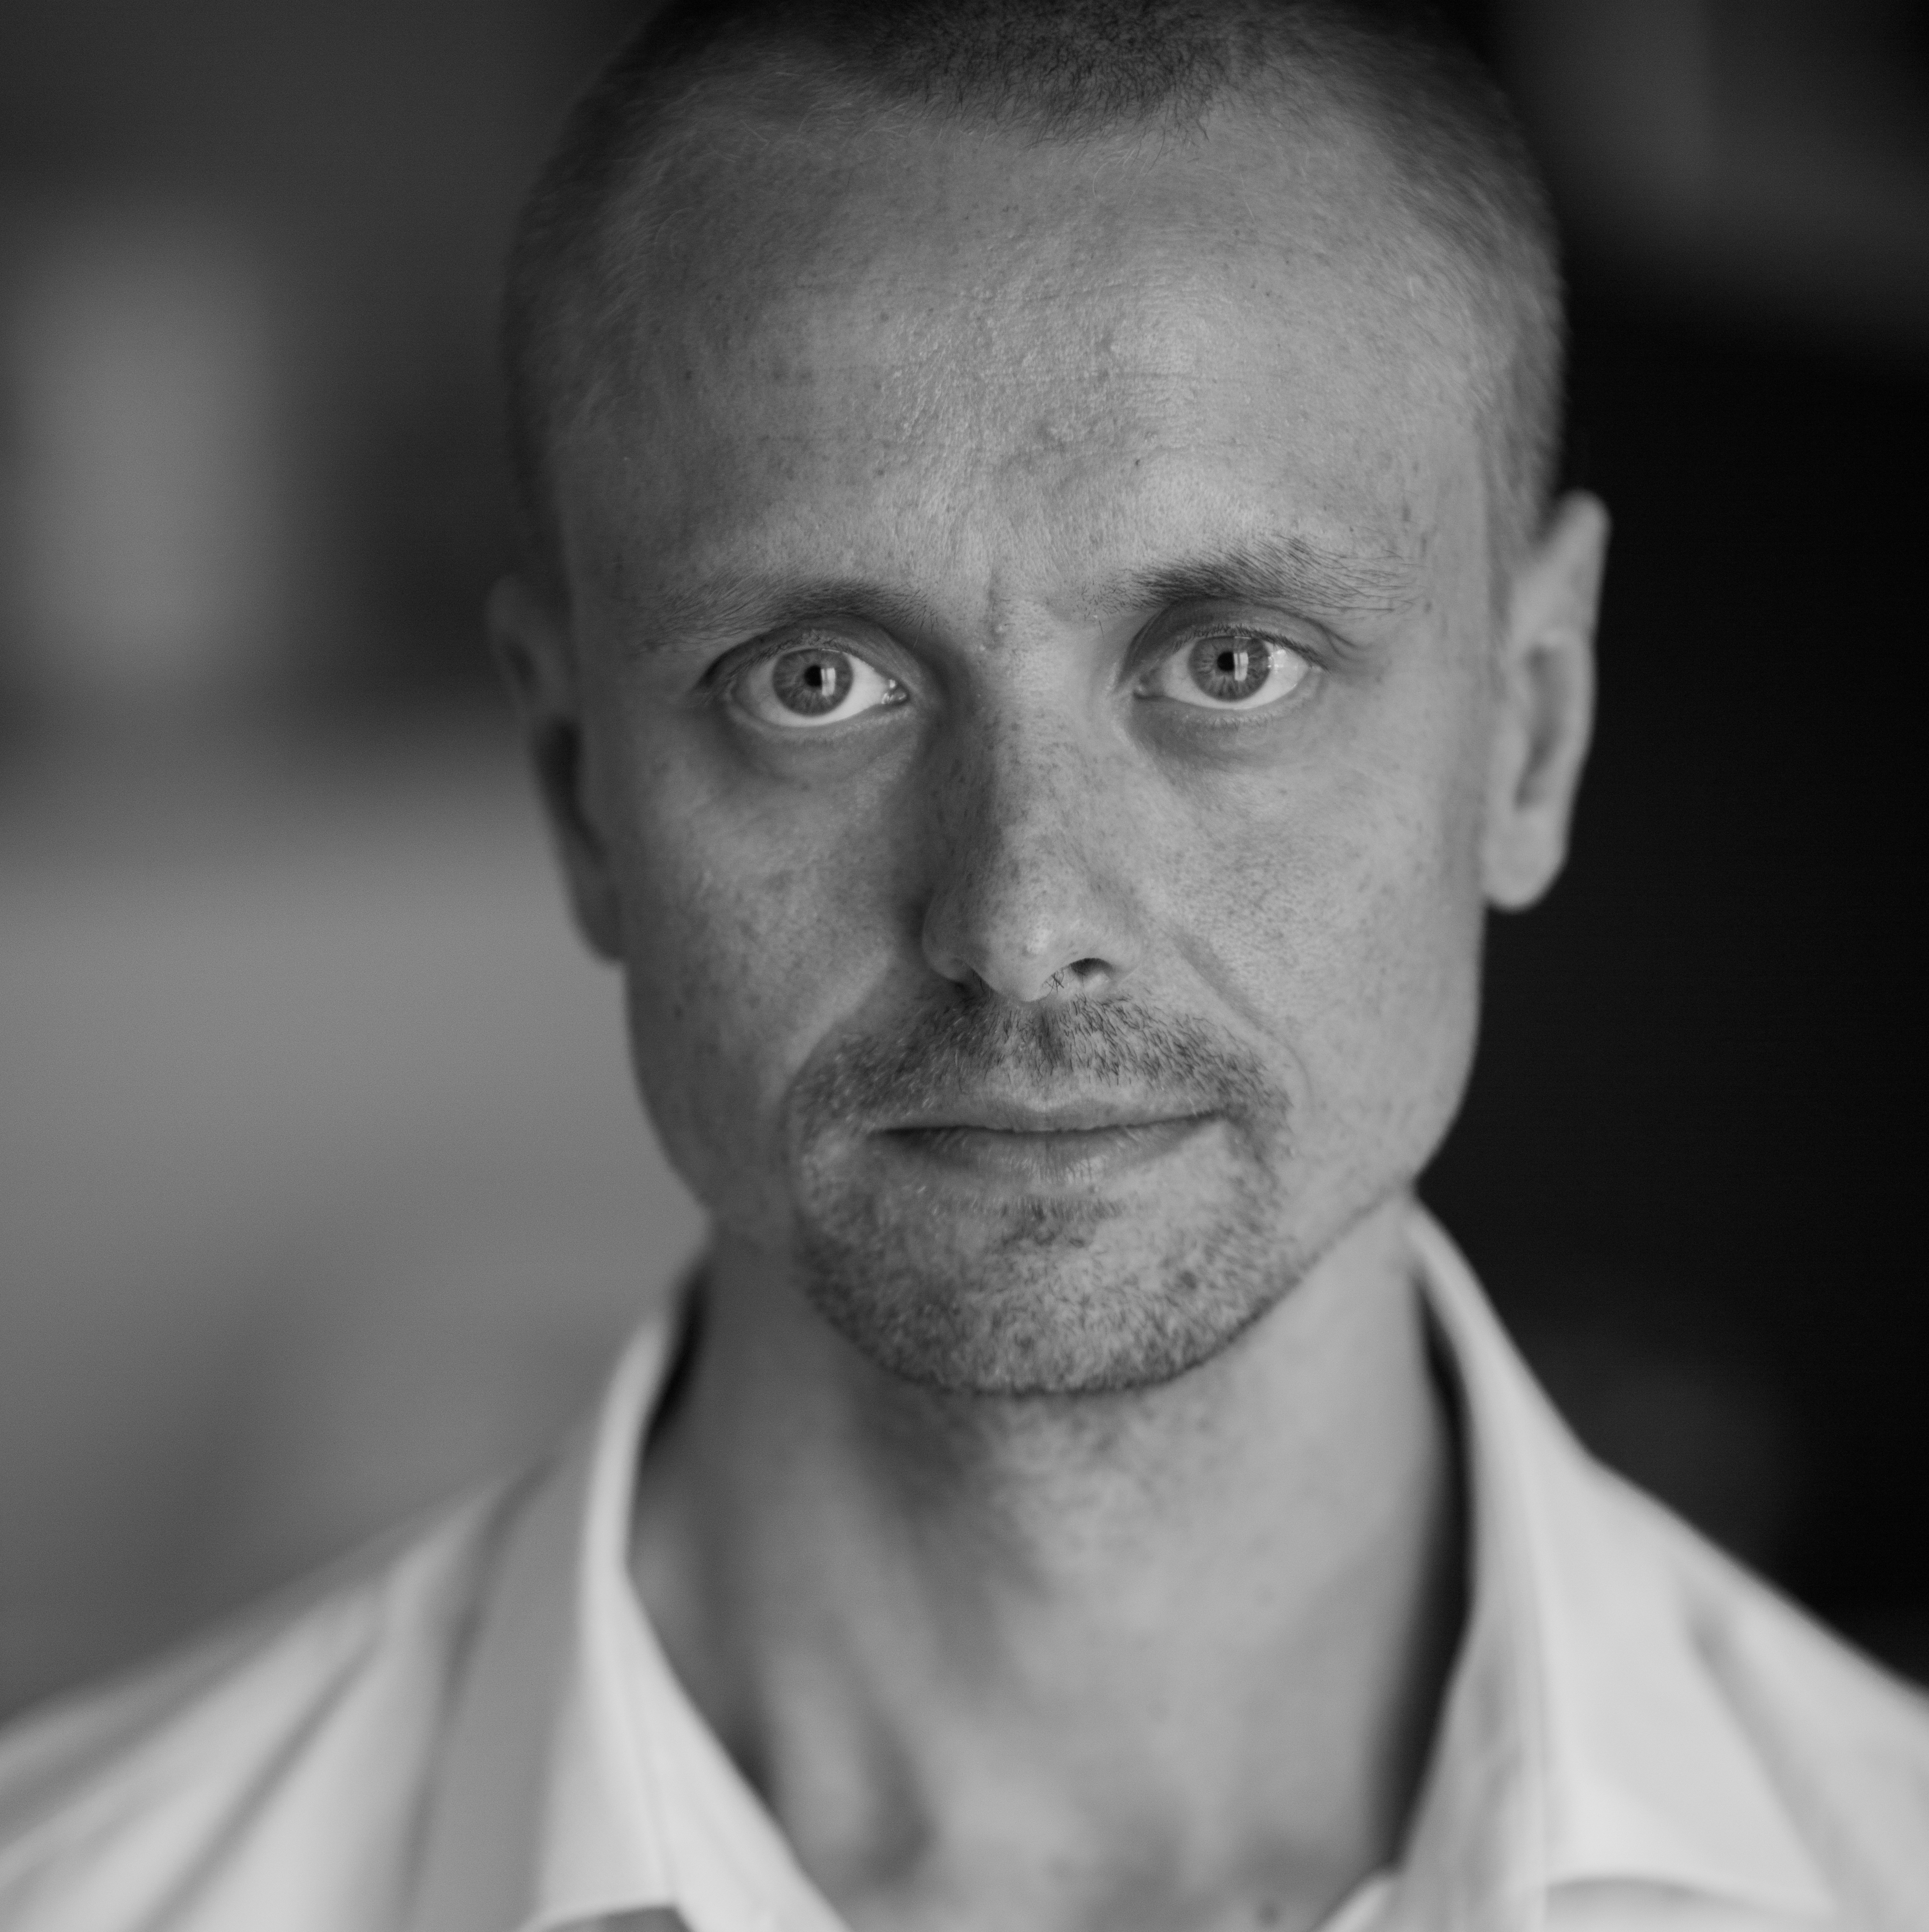
Who am I?
Senior software engineer at EPAM Systems
10+ years experience in IT (Ruby / C++ / other languages)
Key Ruby developer in a huge fin-tech project

Slide 12
What about you?
What is your experience?
What are your expectations?
Have you ever seen “good enough” code?

Slide 13
Why?
Reduce the count of bugs in production
Reduce the price of changes
Increase the happiness of the team

Slide 14
Why?
Reduce the count of bugs in production
Reduce the price of changes
Increase the happiness of the team

Slide 15
Why?
Reduce the count of bugs in production
Reduce the price of changes
Increase the happiness of the team

Slide 16
so…
Let’s get started!

